Slide 1
Pipelines
An overview of pipelining
Single-Cycle versus Pipelined Performance
Pipeline Hazards
Pipelined Datapath and Control.
Datapath walkthrough
Hazards solution
Textbook: P&H. Chapter 4.5.

Slide 2
Laundry example
Ann, Brian, Cathy, Dave each have one load of clothes to wash, dry, fold, and put away
Washer takes 30 minutes
Dryer takes 30 minutes
“Folder” takes 30 minutes
“Stasher” takes 30 minutes to put clothes into drawers
A
B
C
D

Slide 3
Sequential Laundry
6 PM
7
8
9
10
11
12
1
2 AM
T
a
s
k
O
r
d
e
r
30
30
30
30
30
30
30
30
30
30
30
30
30
30
30
30
Sequential laundry takes 8 hours for 4 loads
Time
A
B
C
D

Slide 4
Pipelined Laundry
6 PM
7
8
9
10
11
12
1
2 AM
Pipelined laundry takes 3.5 hours for 4 loads!
30
30
30
30
30
Time
T
a
s
k
O
r
d
e
r
30
30
A
B
C
D

Slide 5
Pipelining (1/2)
6 PM
7
8
9
Pipelining doesn’t help latency of single task, it helps throughput of entire workload
Multiple tasks operating simultaneously using different resources
Potential speedup = Number pipe stages
Time to “fill” pipeline and time to “drain” it reduces speedup: 2.3X v. 4X in this example
T
a
s
k
O
r
d
e
r
Time
30
30
30
30
30
30
30
A
B
C
D

Slide 6
Pipelining (2/2)
6 PM
7
8
9
Suppose new Washer takes 20 minutes, new Stasher takes 20 minutes. How much faster is pipeline?
Pipeline rate limited by slowest pipeline stage
Unbalanced lengths of pipe stages reduces speedup
T
a
s
k
O
r
d
e
r
Time
30
30
30
30
30
30
30
A
B
C
D

Slide 7
Steps in Executing MIPS
1) IFtch: Instruction Fetch, Increment PC
2) Dcd: Instruction Decode, Read Registers
3) Exec: Mem-ref: Calculate Address Arith-log: Perform Operation
4) Mem: Load: Read Data from Memory Store: Write Data to Memory
5) WB: Write Data Back to Register

Slide 8
Single Cycle Datapath
rd
PC
instruction
memory
registers
rs
Data
memory
rt
ALU
+4
imm
2. Decode/
Register Read
1. Instruction
Fetch
5. Write Back
3. Execute
4. Memory

Slide 9
Pipeline registers
rd
PC
instruction
memory
registers
rs
Data
memory
rt
ALU
+4
imm
2. Decode/
Register Read
1. Instruction
Fetch
5. Write Back
3. Execute
4. Memory
Need registers between stages
To hold information produced in previous cycle

Slide 10
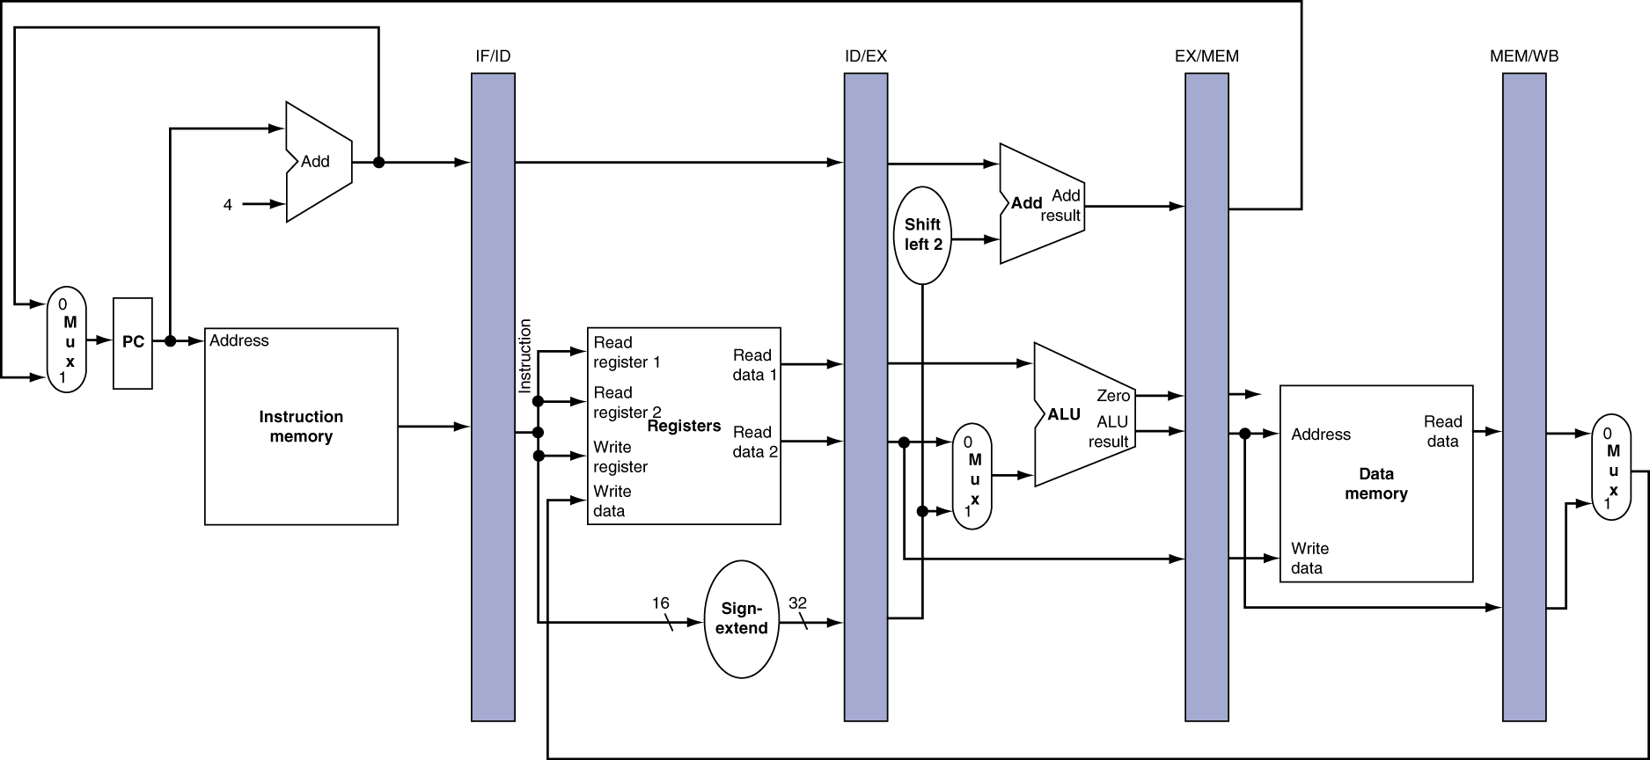
More Detailed Pipeline

Slide 11
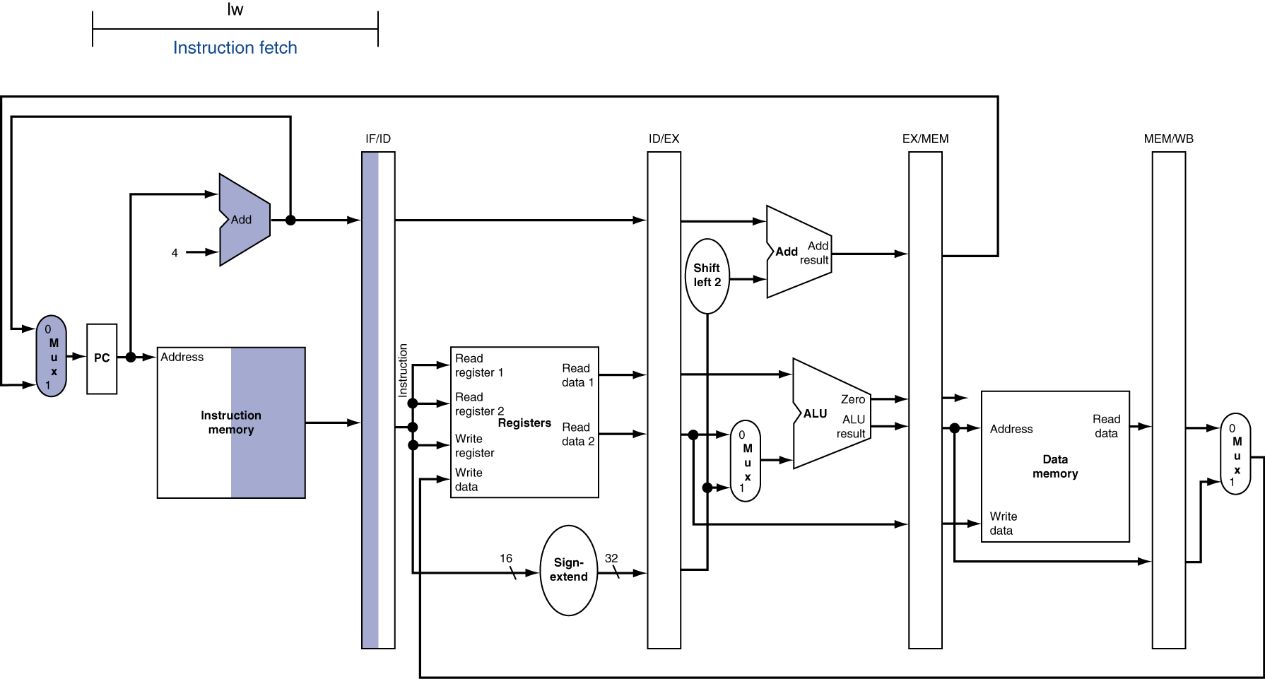
IF for Load, Store, …

Slide 12
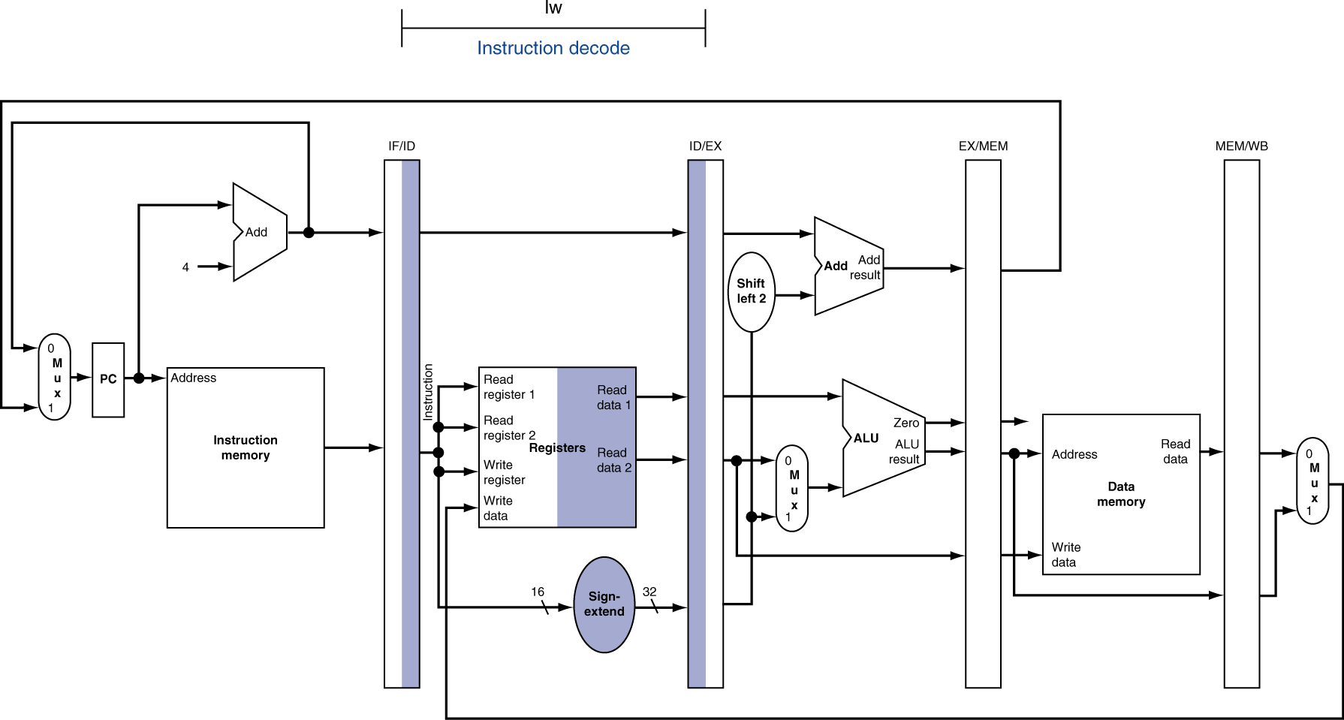
ID for Load, Store, …

Slide 13
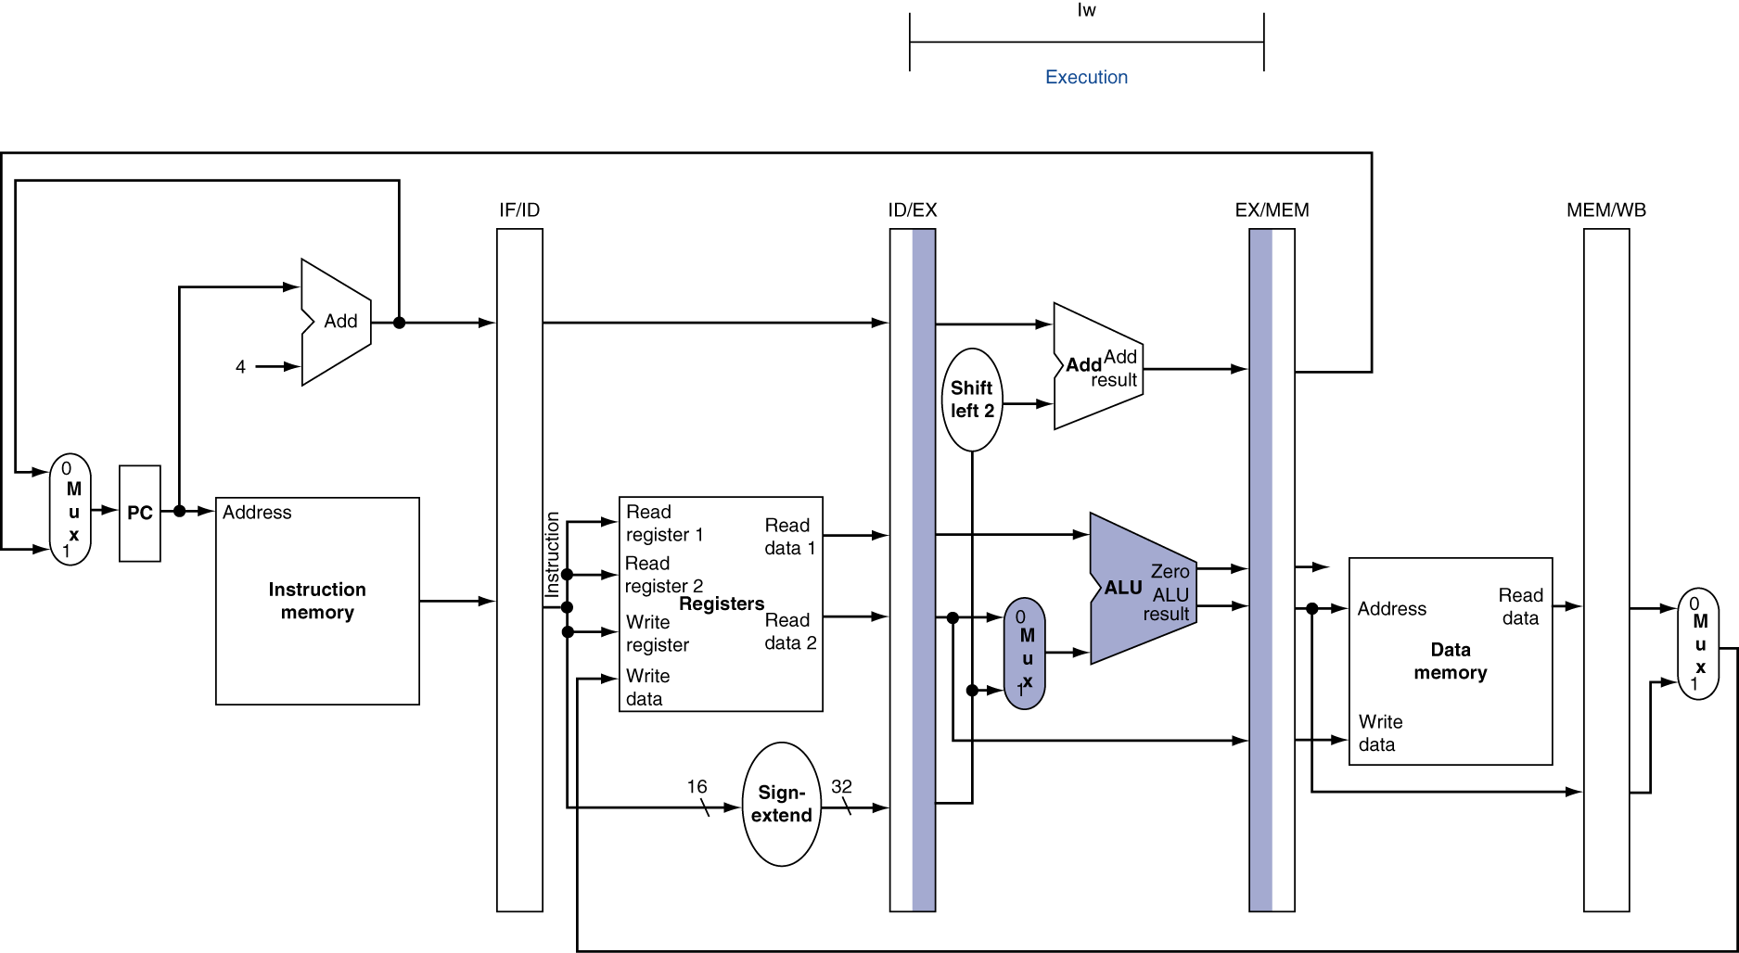
EX for Load

Slide 14
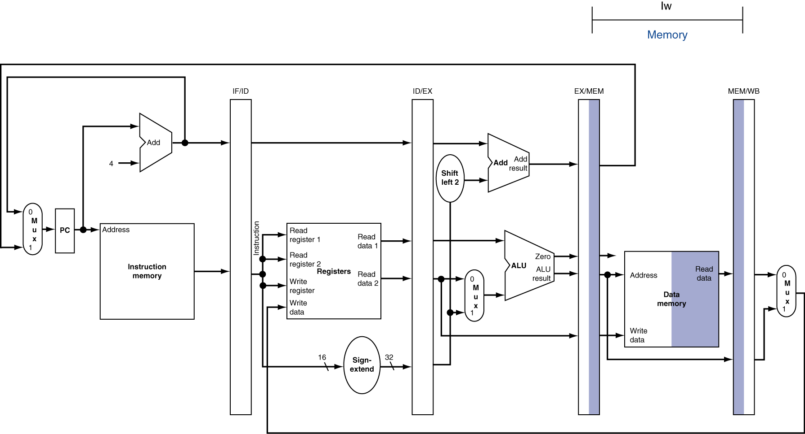
MEM for Load

Slide 15
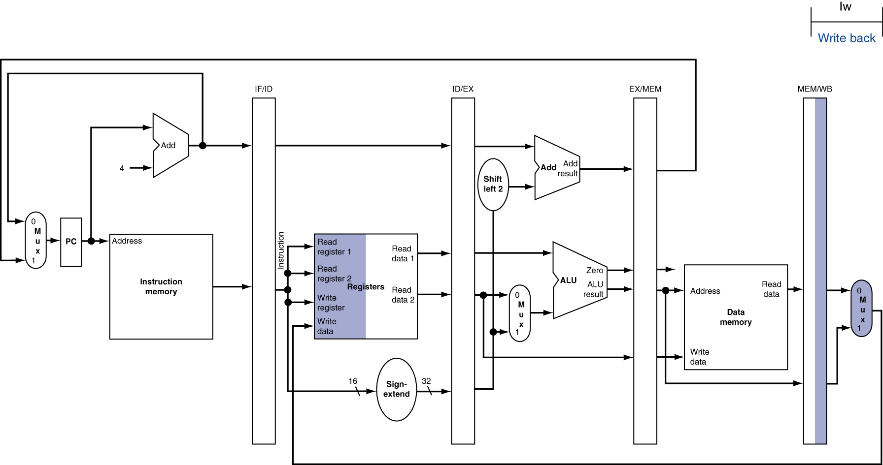
WB for Load – Oops!
Wrong register number

Slide 16
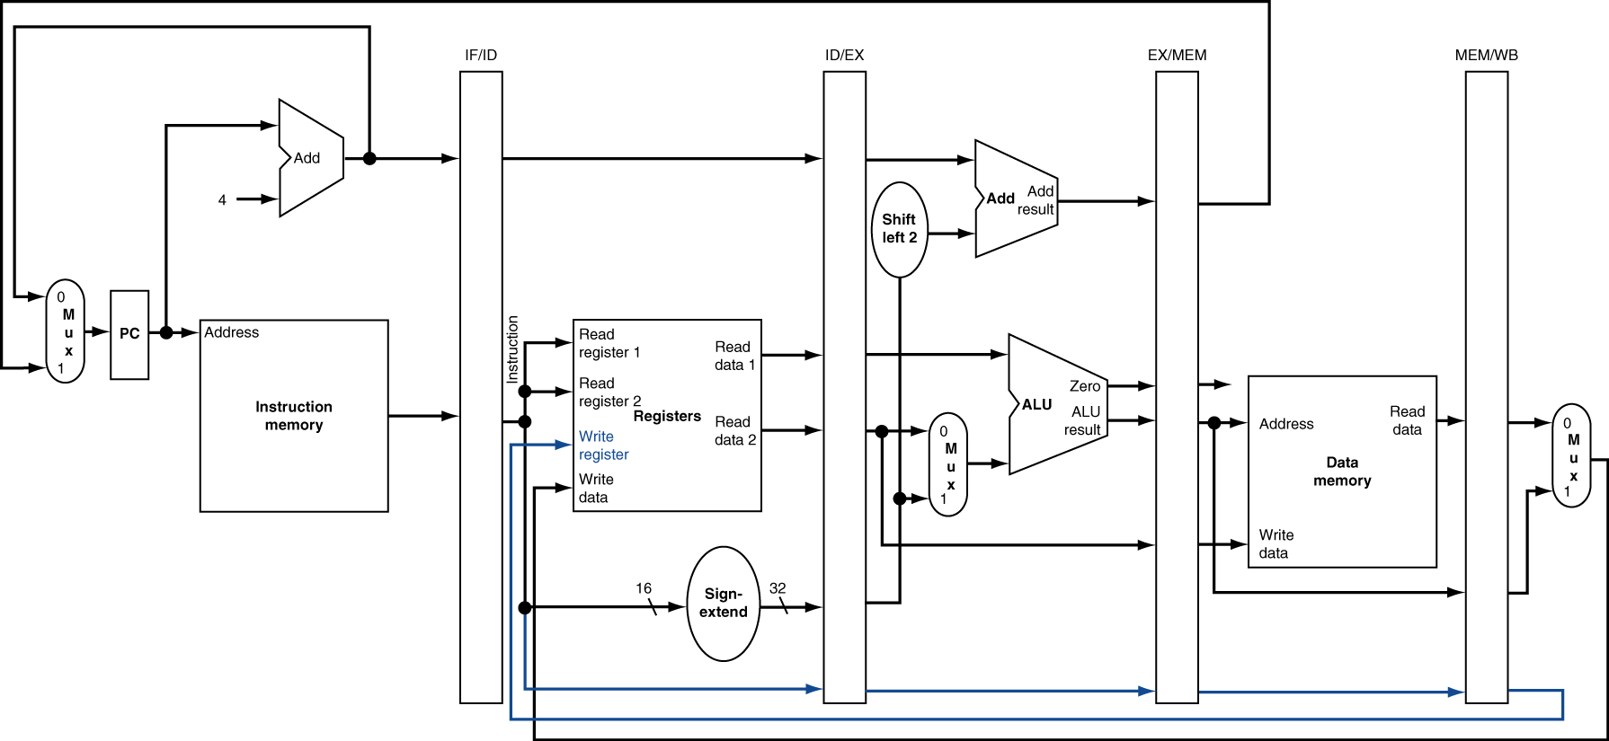
Corrected Datapath for Load

